Slide 1
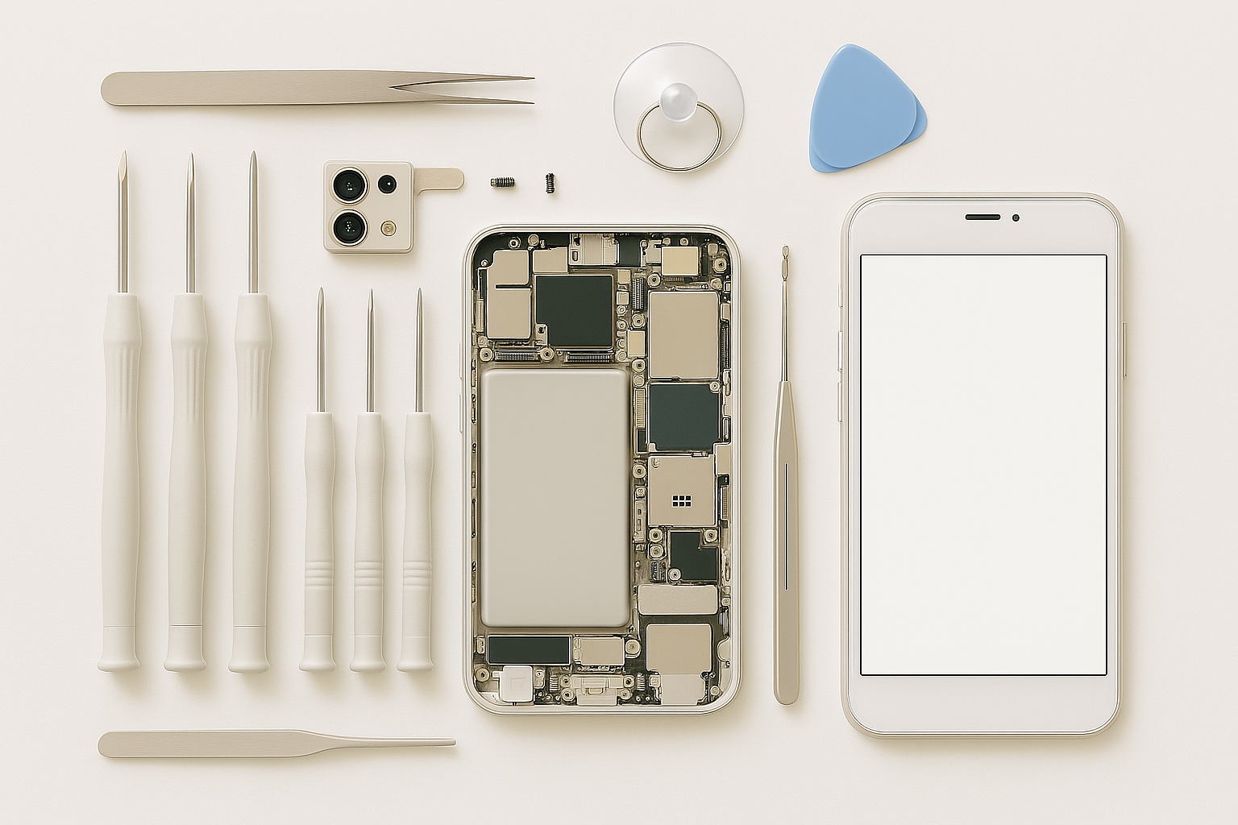
Final Project Statistical Analysis
Common Failure Types in Electronic Device Repairs
Exploring the relationship between device type and repair success
Course: INDE 6333 - Probability and Statistics for Engineers Instructor: Dr. Nirathi Keerthi Govindu Student: Lujia Wu Date: July 30, 2025

Slide 2
Background & Objectives
Project Focus:
Common failure types in electronic device repairs
Engineering Relevance:
Useful for reliability analysis, repair optimization, and consumer service quality.
Main Objectives:
Identify frequent problems in different device types
Analyze device-wise repair success rates
Test if device type affects repair outcome
Research Question:
Is there a statistically significant association between device type and repair success?

Slide 3
Dataset Overview
Source: Kaggle – Repair Phone Technician
https://www.kaggle.com/datasets/mohamedaminesoltani/repair-phone-technician/data
Total Records: 528 repair entries
Key Columns:
Name: Device brand/model
Type: Device type (SMARTPHONE, CELL, PAD)
Problem: Type of issue (e.g., lcd, charge, off)
Fixed YES/NO: Indicates whether the device was successfully repaired
Why this dataset?
Real-world, engineering-relevant data
Categorical structure enables statistical testing
Useful for reliability/performance assessment

Slide 4
Statistical Methods Used
1. Descriptive Statistics
Count of devices by type
Repair outcomes (YES/NO)
Success rate calculation by device
2. Frequency Analysis
Count of each problem type
Identification of most frequent issues (e.g., lcd, charge)
3. Chi-Square Test of Independence
Tested association between device type and repair success
Observed vs. expected counts
Significance determined using p-value
Tools Used: Microsoft Excel (PivotTables, formulas, CHISQ.TEST)

Slide 5
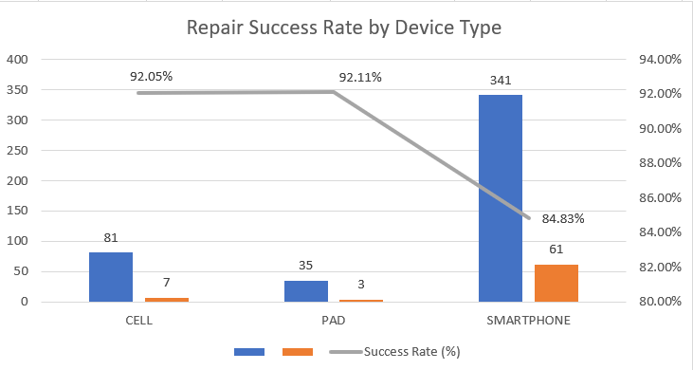
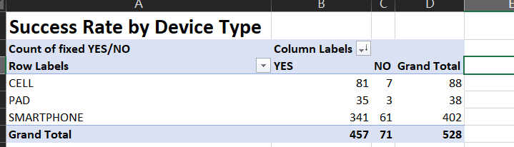
Key Findings and Interpretation 1
Repair Success Rates
SMARTPHONE: 84.83% (341/402)
CELL: 92.05% (81/88)
PAD: 92.11% (35/38)
average success rate of about 86.6%.
PAD and CELL had slightly higher success rates than SMARTPHONE.

Slide 6
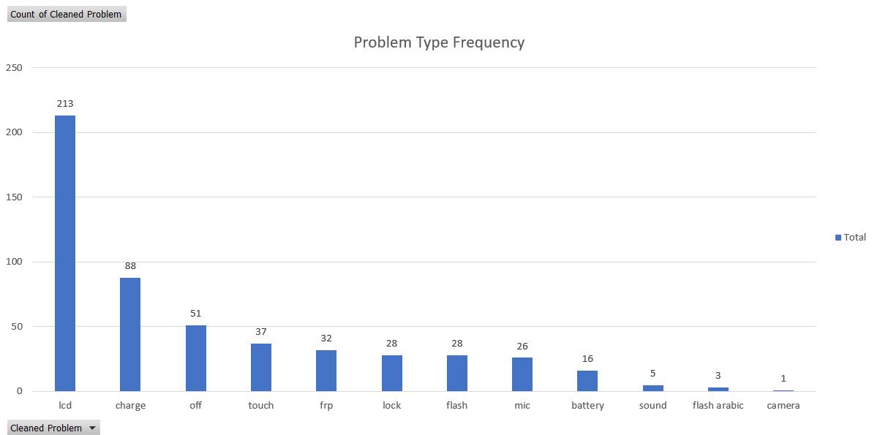
Key Findings and Interpretation 2
Most Frequent Problems
LCD issues: 213
Charging issues: 88
Power-off (won’t turn on): 51
Touch screen issues: 37

Slide 7
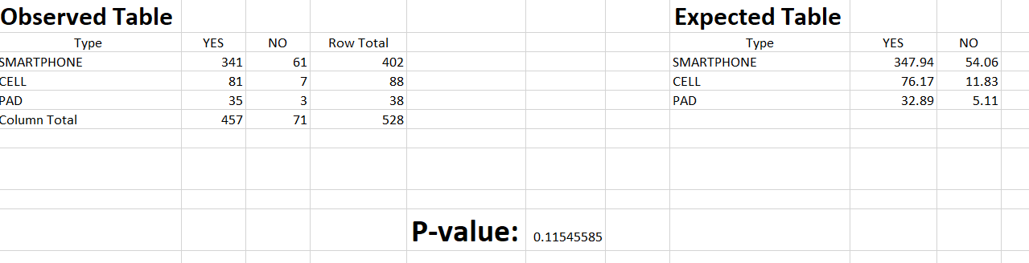
Key Findings and Interpretation 3
Chi-Square Test Results
χ² = 4.3144, df = 2, p = 0.1155
p > 0.05 → No significant association
Cannot conclude that device type affects repair success

Slide 8
Conclusion
The goal of this statistical analysis project was to explore whether the type of electronic device impacts the likelihood of successful repair. Using a real-world dataset of 528 repair records from Kaggle, we performed descriptive statistics, frequency analysis, and a Chi-Square test of independence. The descriptive analysis revealed that while CELL and PAD devices exhibited slightly higher repair success rates than SMARTPHONES, the overall repair success rate was high across all device types at 86.55%. Most repair issues were concentrated around LCD and charging problems, which together accounted for over 50% of all cases. Hypothesis testing using a chi-square statistic (χ² = 4.3144, df = 2) yielded a p-value of 0.1155. Since this value is greater than the common significance level of 0.05, we failed to reject the null hypothesis. This indicates that the observed differences in repair success rates among device types are not statistically significant.

Slide 9
Recommendations
Improve design and quality of LCD and charging components to reduce common failure rates.
Provide enhanced technician training for high-frequency problem types.
Implement standardized diagnostic procedures to improve repair consistency.
Track repeat repairs to detect chronic issues and potential design flaws.
Conduct periodic quality audits to monitor technician performance and ensure service reliability.
Gather post-repair customer feedback to assess satisfaction and real-world outcomes.
Analyze the cost-benefit ratio of repairs to support data-driven decision-making.

Slide 10
Thank you

